Slide 1
DeepYellowj
The Development of Chess AI
By: Ahmad Nazeri

Slide 2
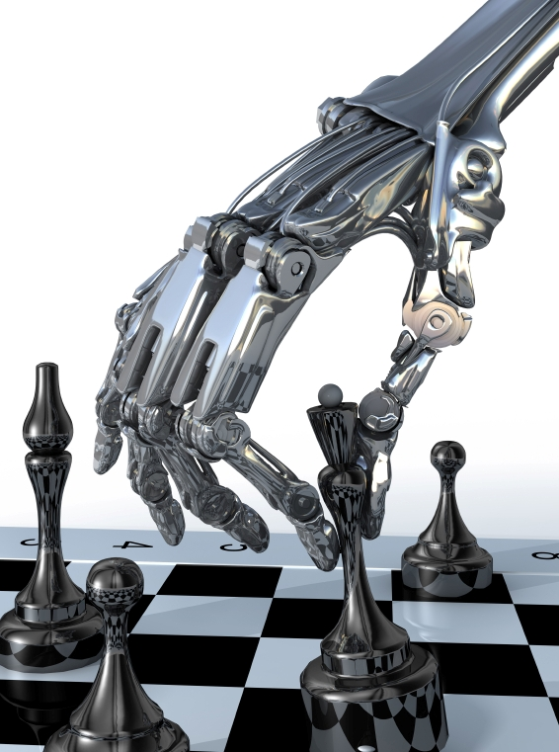
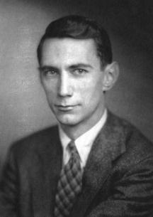
Why Chess Artificial Intelligence?
Combination of 3 things I love
Chess
Math
Computer Science
Notes:
Chess- have been playing since elementary school
Math – Enjoying it since I first formally learn math
Science – Programming since, well, four years ago

Slide 3
Goal of Project
Utilize Python & EzGraphics
Chess AI
(DeepYellowJ)
Notes:
Talk about liberal arts education and course work (112, 213, 481 AI, 220)

Slide 4
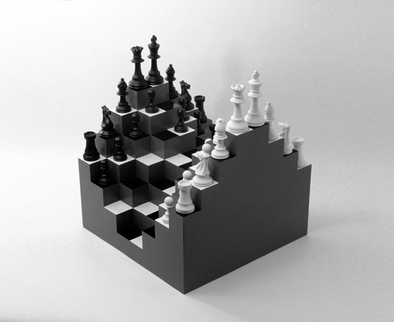
Steps TO DeepYellowJ
Research – Claude Shannon
Plan & Design
Implement the chess board with pieces
Implement the rules of the game* (Human vs Human)
Implement the AI (Human vs Computer)

Slide 5
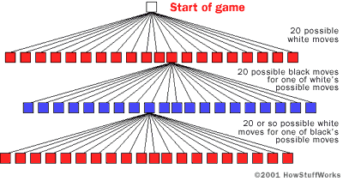
Research: Claude Shannon
Programming a computer to play chess
Evaluation function f(p)
Any given position of chess must be either:
A win position for white +1
A draw position 0
A win position for black -1

Slide 6
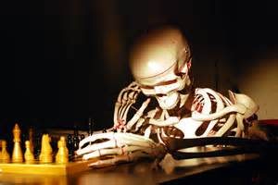
Research: Claude Shannon
30 legal moves
White & Black, 10³ moves
Average moves per game: 40 moves, 10¹²⁰ moves
Downside: 10⁹⁰ years
Notes:
We know that wouldn’t work…but what now….

Slide 7
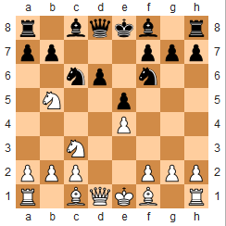
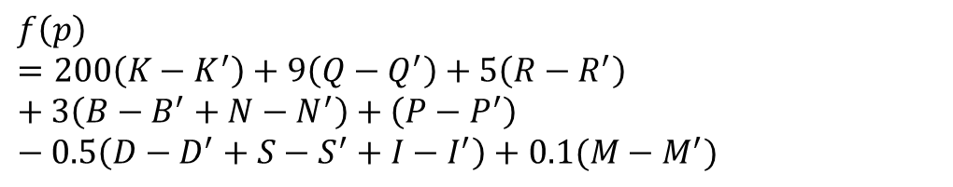
Research: Claude Shannon
f(p) = approximate evaluation function
(K, Q, R, B, N, P) = (King, Queen, Rook, Bishop, Knight, Pawn)
(D, S, I) = (Doubled, backward, isolated pawns)
M = Mobility
$$f\left(p\right) =200\left(K−K^{′}\right)+9\left(Q−Q^{′}\right)+5\left(R−R^{′}\right)+3\left(B−B^{′}+N−N^{′}\right)+\left(P−P^{′}\right) −0.5\left(D−D^{′}+S−S^{′}+I−I^{′}\right)+0.1(M−M^{′})$$
Notes:
Next Step- Plan & Design

Slide 8
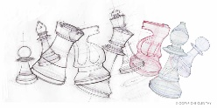
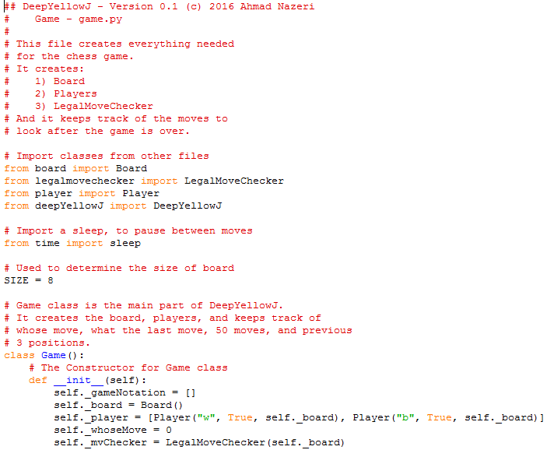
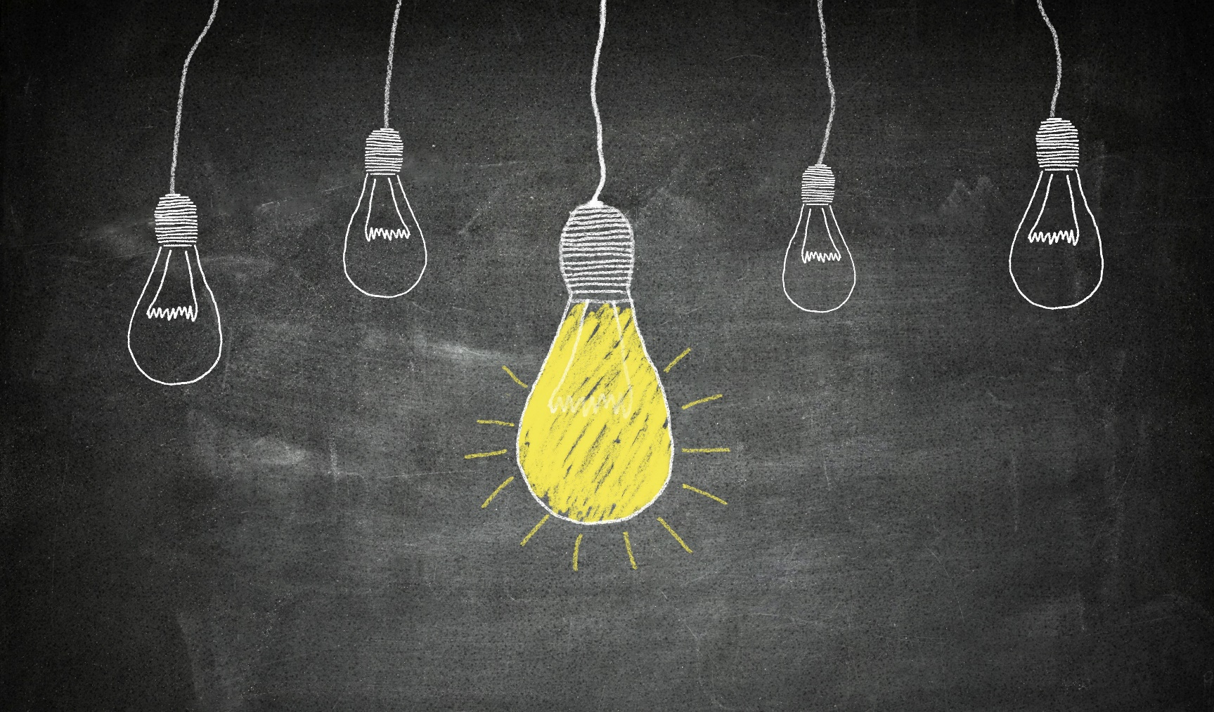

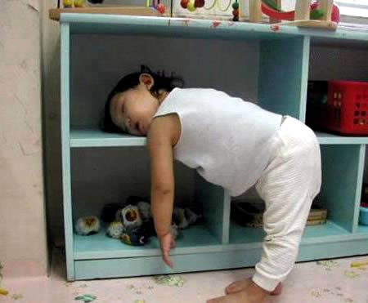
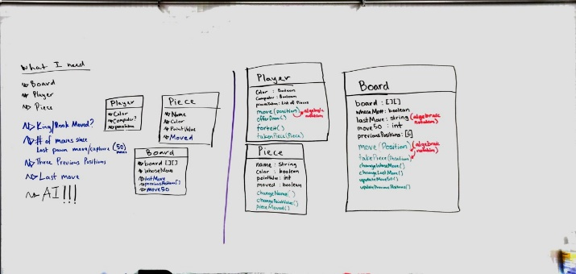
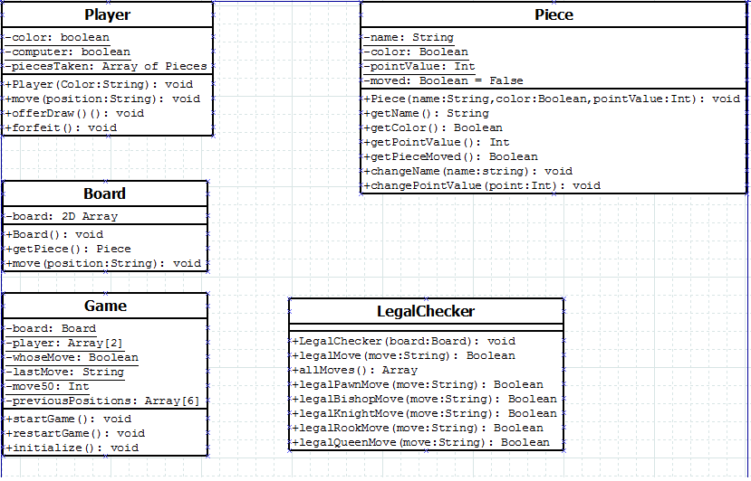
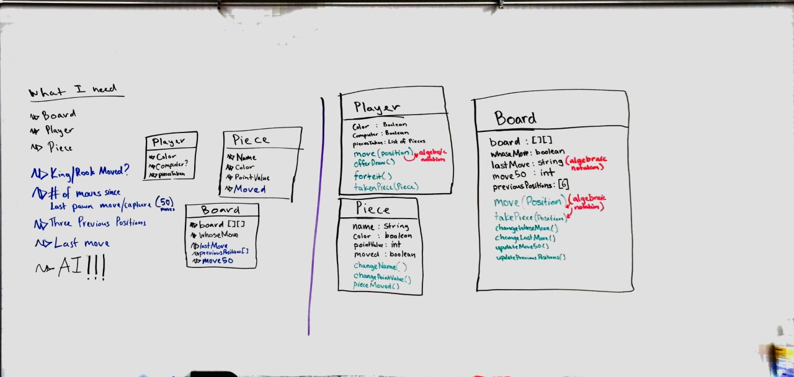
Plan & Design
Idea
Whiteboard
Dia Diagrams
Sleep
Coding
Notes:
Idea- It starts w/ idea and research
Whiteboard- writing, erasing, and rewriting, and moving back to see the big picture
Diagrams- Transfer WB to Dia
(Next step is best part) Sleep- Catch up on some sleep
Coding (112, 213, 481 AI, 220)

Slide 9
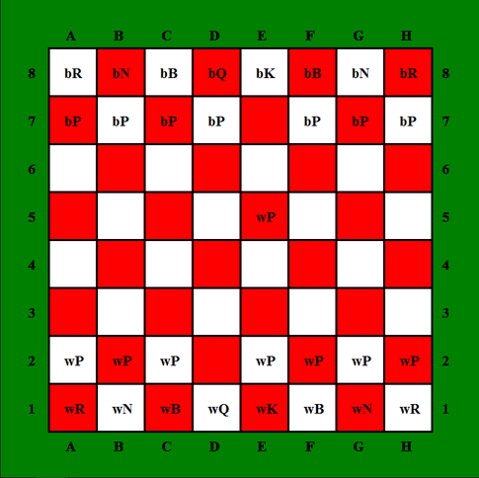
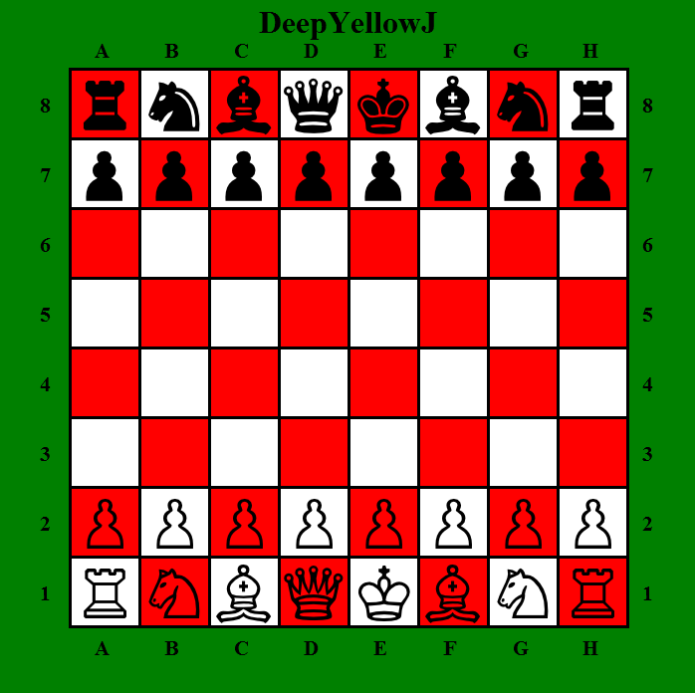
Developing Chess Board and Pieces
Board
Coloring
Pieces
Displaying Pieces
Board & Pieces
Movement of Pieces
Notes:
Board- Problem with coloring
Pieces- Problem with displaying pieces
Board & Pieces – What I did to fix them
Movement of Pieces – Use 2-square notation to move pieces

Slide 10
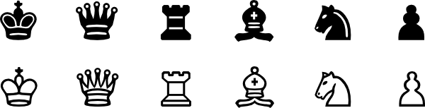
Implement Rules of the game
Rules for each piece
Keeping Track
Whether king and rooks have moved
Last move
Number of moves since last pawn move or capture
Three previous positions
Notes:
Rules – talk about some rules
King & Rook – castling
Last move – en passante
Number of moves – stalemate
Three previous positions – stalemate by repetition

Slide 11
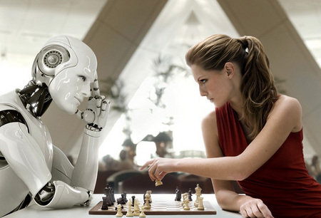
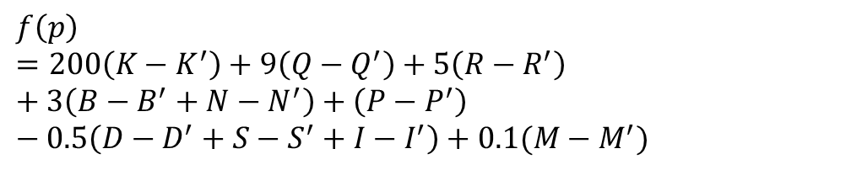
Creating The AI: DeepYellowJ
Find All Moves
Utilize the f(p):
Pick the best move!
$$f\left(p\right) =200\left(K−K^{′}\right)+9\left(Q−Q^{′}\right)+5\left(R−R^{′}\right)+3\left(B−B^{′}+N−N^{′}\right)+\left(P−P^{′}\right) −0.5\left(D−D^{′}+S−S^{′}+I−I^{′}\right)+0.1(M−M^{′})$$
Notes:
FAM- Utilizes similar algorithms as the rules to find moves
F(p) – the approximate function to determine best move
Pick the best move- Picks the move with maximum value

Slide 12
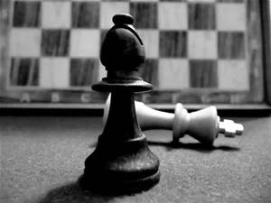
DeepYellowJ: Current Stage
Version 0.1
Two Square Move
Checks majority of rules
En Passante
Check/mates
Game ends when a player takes the opponent’s King

Slide 13
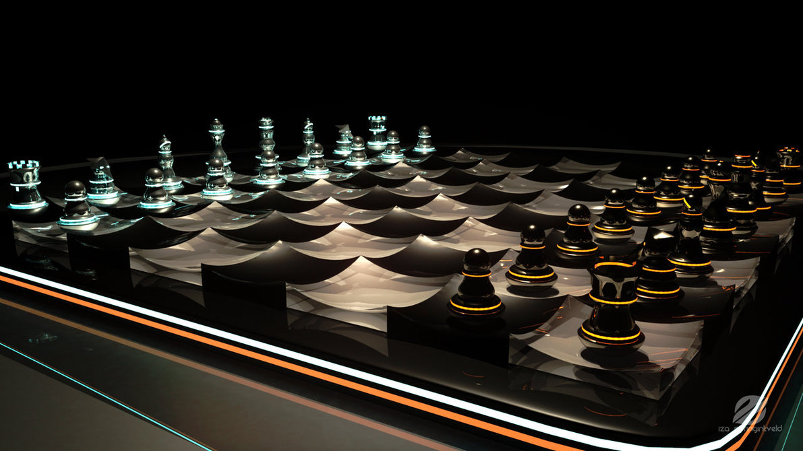
In the future…
Finish the rules
Search more in-depth
Heuristic function
Opening & Ending Moves
Algebraic notation
Release Version1.0 by August

Slide 14
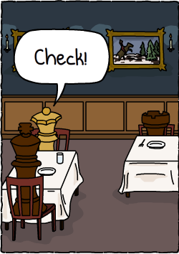
Checkmate: What I learned!
Importance of Design
Details matter
Circularity of Development
Sharpen my development skills

Slide 15
One Last thing
. . .

Slide 16
Thank you!
&
Questions

